Slide 1
Evaluating the accuracy of cancer diagnostic tests

Slide 2

Many Ovarian Cancers Develop Genomic Instability
Genomic Instability is a feature of certain cancers and is caused by defective DNA repair, for example when the BRCA1 gene is lost
Why Measure Genomic Instability
A new class of drug is very effective at killing cancer cells that have Genomic Instability, but it is not toxic to normal cells.
Genomic Instability is now an important biomarker predicting benefit from these drugs. Patients whose tumors lack Genomic Instability will not benefit.
When BRCA1 is lost, double strand breaks don’t get repaired properly

Slide 3
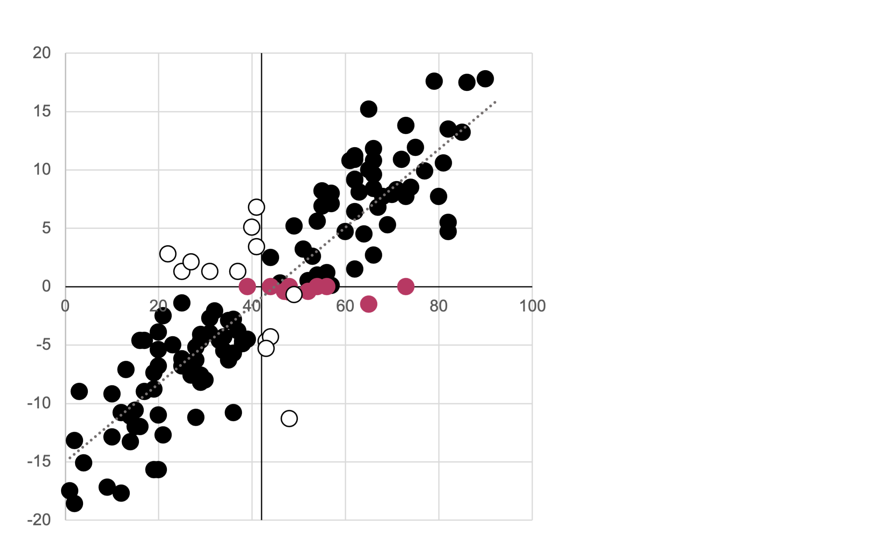
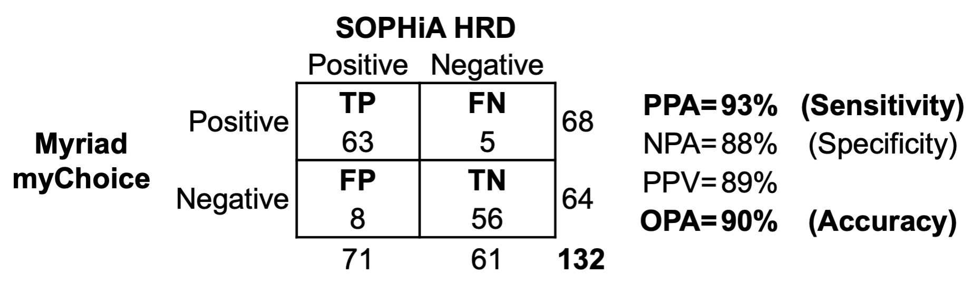
Tests that Measure Genomic Instability are not 100% accurate
We compared a Genomic Instability test from SOPHiA Genetics with a reference test from Myriad Genetics
SOPHiA Genetics agreed with Myriad Genetics only 93% of the time
SOPHiA GI Index
Myriad GI Score

Slide 4
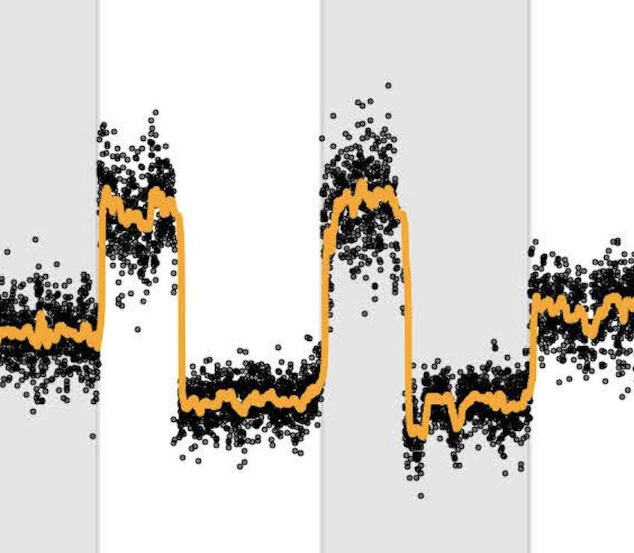
We asked, what characteristics of a test or sample is associated with disagreement?
Can we predict if a result generated by SOPHiA Genetics is at risk of being false without performing the Myriad Genetics reference test?
Each Myriad Genetics test generates several features that can be used to train a model that would help us accept or reject the cancer test result.
Normalized WGS coverage plot
Smoothed WGS coverage plot
The agreement, or lack of, between both tests, performed on our series of 139 ovarian cancer samples, can be used as the target for training our models.
Signal-Noise Ratio
Residual Noise
Signal
Purity-Ploidy Ratio

Slide 5
Method
(1) We obtained cancer test results from Peter MacCallum Cancer Centre and loaded all results into MongoDb. (2) We, cleaned, normalised and standardised the data in preparation for machine learning. (3) We used the data to train and test several predictive models. Model outcomes were also stored in MongoDb. (4) We produced accuracy reports and visualisations to determine whether our training was successful. (5) We applied our models to an independent set of test results to assess their ability to reject results at risk of being false.

Slide 6
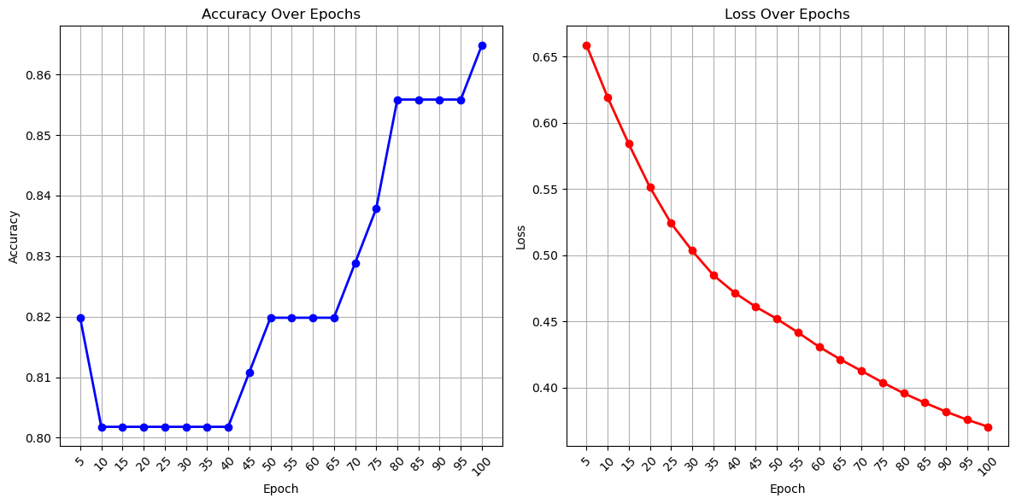
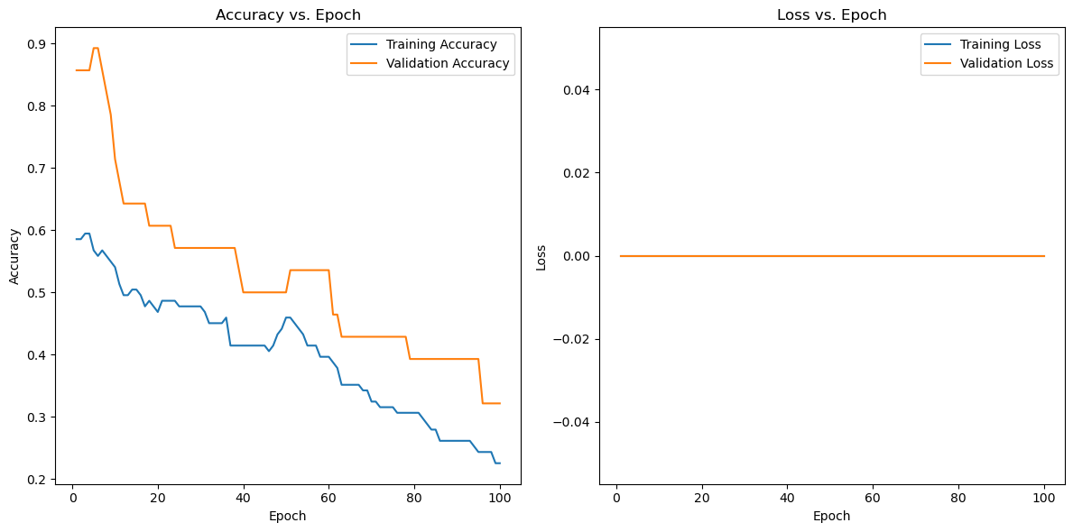
Neural Network

Slide 7
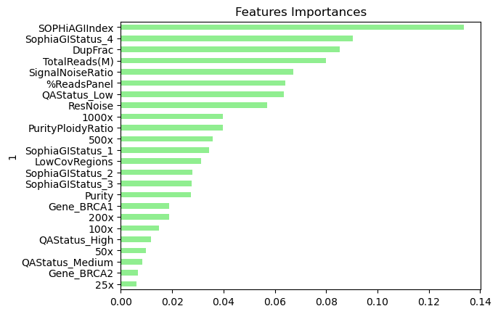
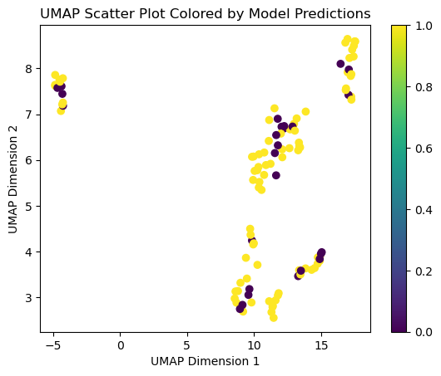
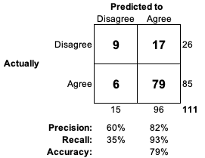
Random Forest Model
Random Forest works well with smaller data sets and is very explainable compared to other ML algorithms
This model is quite good at predicting a correct test result (recall 93%) but very poor at predicting an incorrect test result (recall 35%)

Slide 8
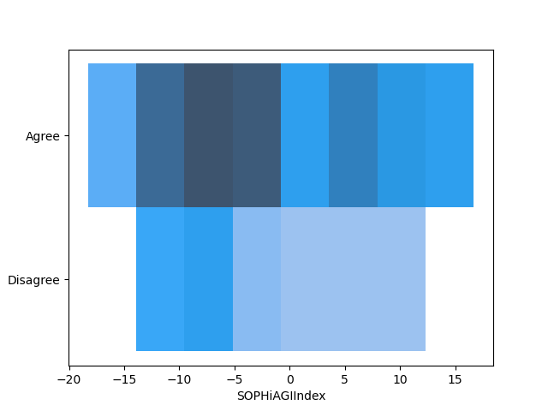
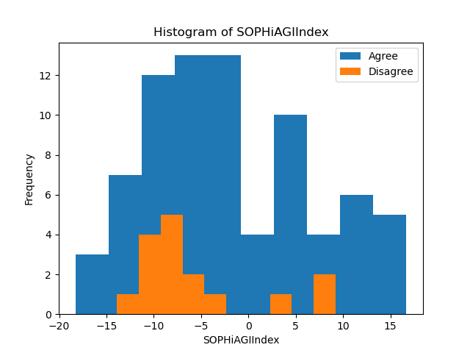
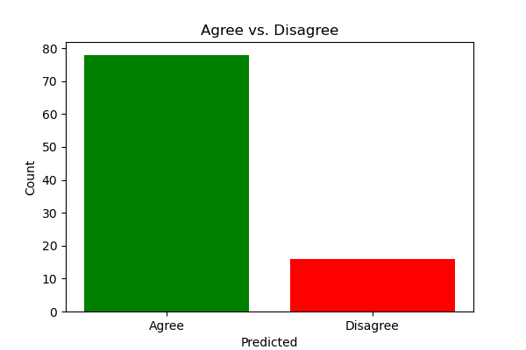
Predictions

Slide 9
Lessons learned and suggestions for Improvement

Slide 10

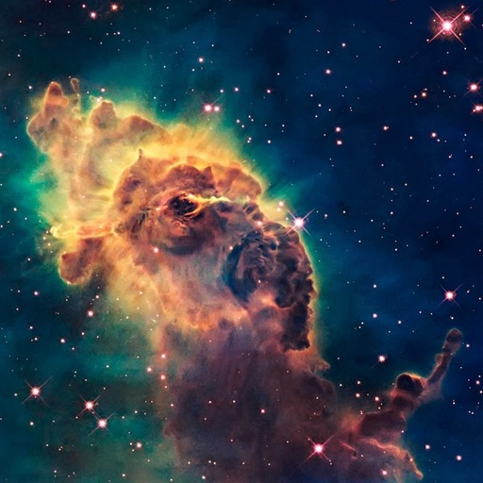


Thank you for listening We are: Andrew Fellowes Roberto Sammassimo Richard Soos Richard Thornton We are glad its over

